Slide 1
Roaming Wars
How Different Devices Roam
- Jerry Olla -

Slide 2
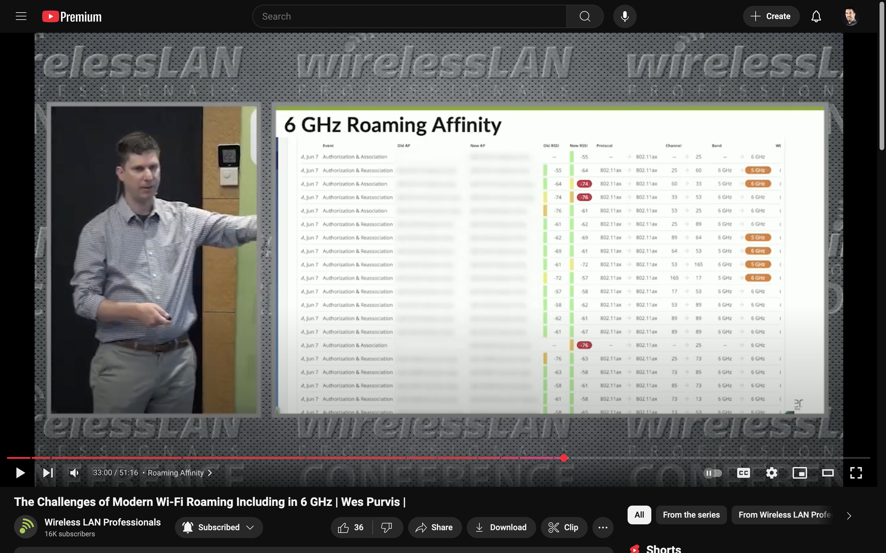
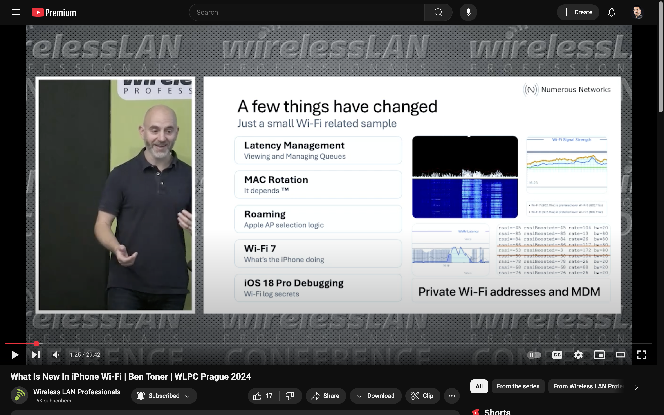
Previous related WLPC sessions
The Challenges of Modern Wi-Fi Roaming Including in 6 GHz | Wes Purvis
What Is New In iPhone Wi-Fi | Ben Toner

Slide 3




Devices Tested
Apple M2 MacBook Pro (Wi-Fi 6E)
Apple iPhone 15 Pro (Wi-Fi 6E)
Windows 11 (24H2) Laptop
Intel BE200 (Wi-Fi 7)
Intel AX210 (Wi-Fi 6E) – Failed
MediaTek MT7922 (Wi-Fi 6E)
MediaTek MT7902 (Wi-Fi 6E)
Qualcomm WCN7851 (Wi-Fi 7)
Android Pixel 8 (Wi-Fi 7)

Slide 4
Drivers / OS
Windows 11 24H2 26100.2894
Intel Driver: 11/11/2024 23.100.0.4 (BE200)
MediaTek Driver: 6/11/2024 3.4.2.1046 (MT7902/MT7922)
Qualcomm Driver: 12/1/2023 3.0.0.1078 (WCN7851)
iPhone 15 Pro
iOS 18.3
M2 MacBook Pro
macOS 15.2 (Sequoia)
Google Pixel 8
Android 15
NOTE: All adapter/roaming options left at defaults

Slide 5


Roaming Test – Manual Method
Aruba AP-735
(Wi-Fi 7)
Aruba AP-735
(Wi-Fi 7)

Slide 6
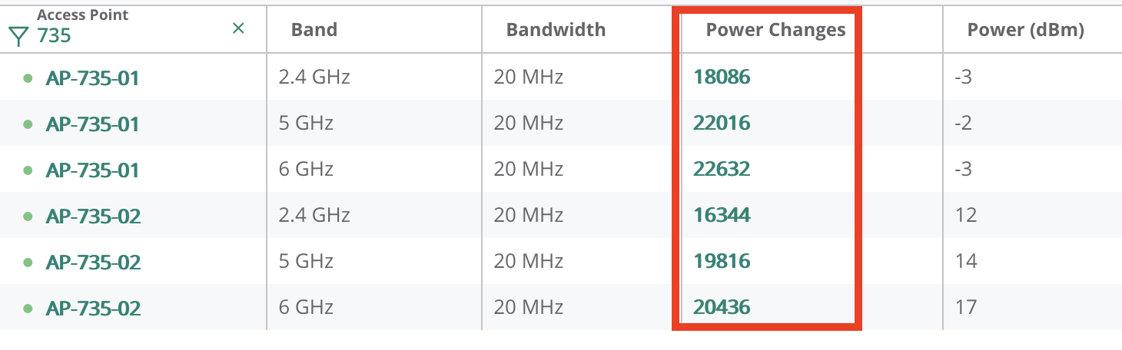
Roaming Test - Automated Method
Automatically adjusted Tx power of each radio in +/- 1 dB increments every 3 seconds
RSSI levels balanced across bands – 2.4 GHz clamped to 6 dB less than 5/6 GHz
Devices in the same location and orientation for each test
60 min / 20 “power” cycles - per test
Captured 1000+ roaming events

Slide 7

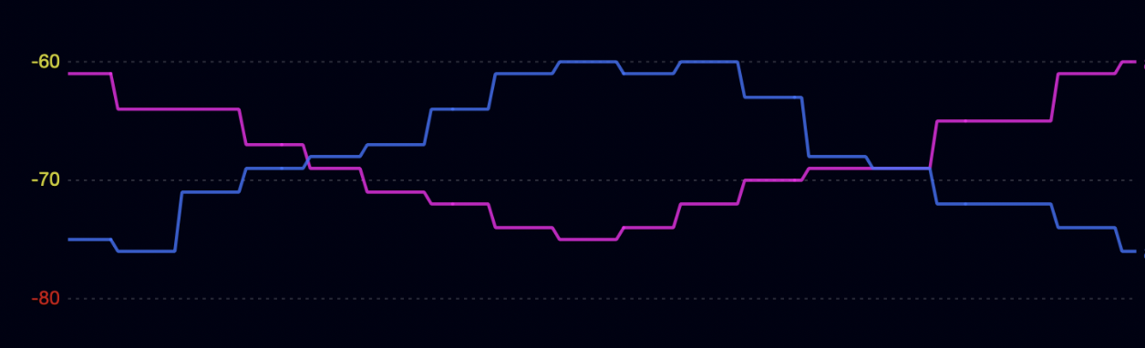
Roaming Test - Automated Method

Slide 8
Do Tri-band devices Really prefer 6 GH?

Slide 9
Tri-Band 2.4/5/6 GHz - 20/20/20 MHz Baseline – All things equal
Device | 2.4GHz | 5GHz | 6GHz | Roams
Google Pixel 8 (Wi-Fi 7) | 65% | 9% | 26% | 34
Intel BE200 (Wi-Fi 7) | 0% | 0% | 100% | 15
iPhone 15 Pro (Wi-Fi 6E) | 54% | 15% | 31% | 13
M2 MacBook Pro (Wi-Fi 6E) | 0% | 0% | 100% | 19
MediaTek MT7902 (Wi-Fi 6E) | 12% | 71% | 18% | 17
MediaTek MT7922 (Wi-Fi 6E) | 0% | 71% | 29% | 19
Qualcomm WCN7851 (Wi-Fi 7) | 0% | 68% | 32% | 19
Notes:
No incentive other than band/frequency
Intel BE200 and MacBook Pro, they love 6 GHz

Slide 10
Do Tri-band devices prefer wider channels?

Slide 11

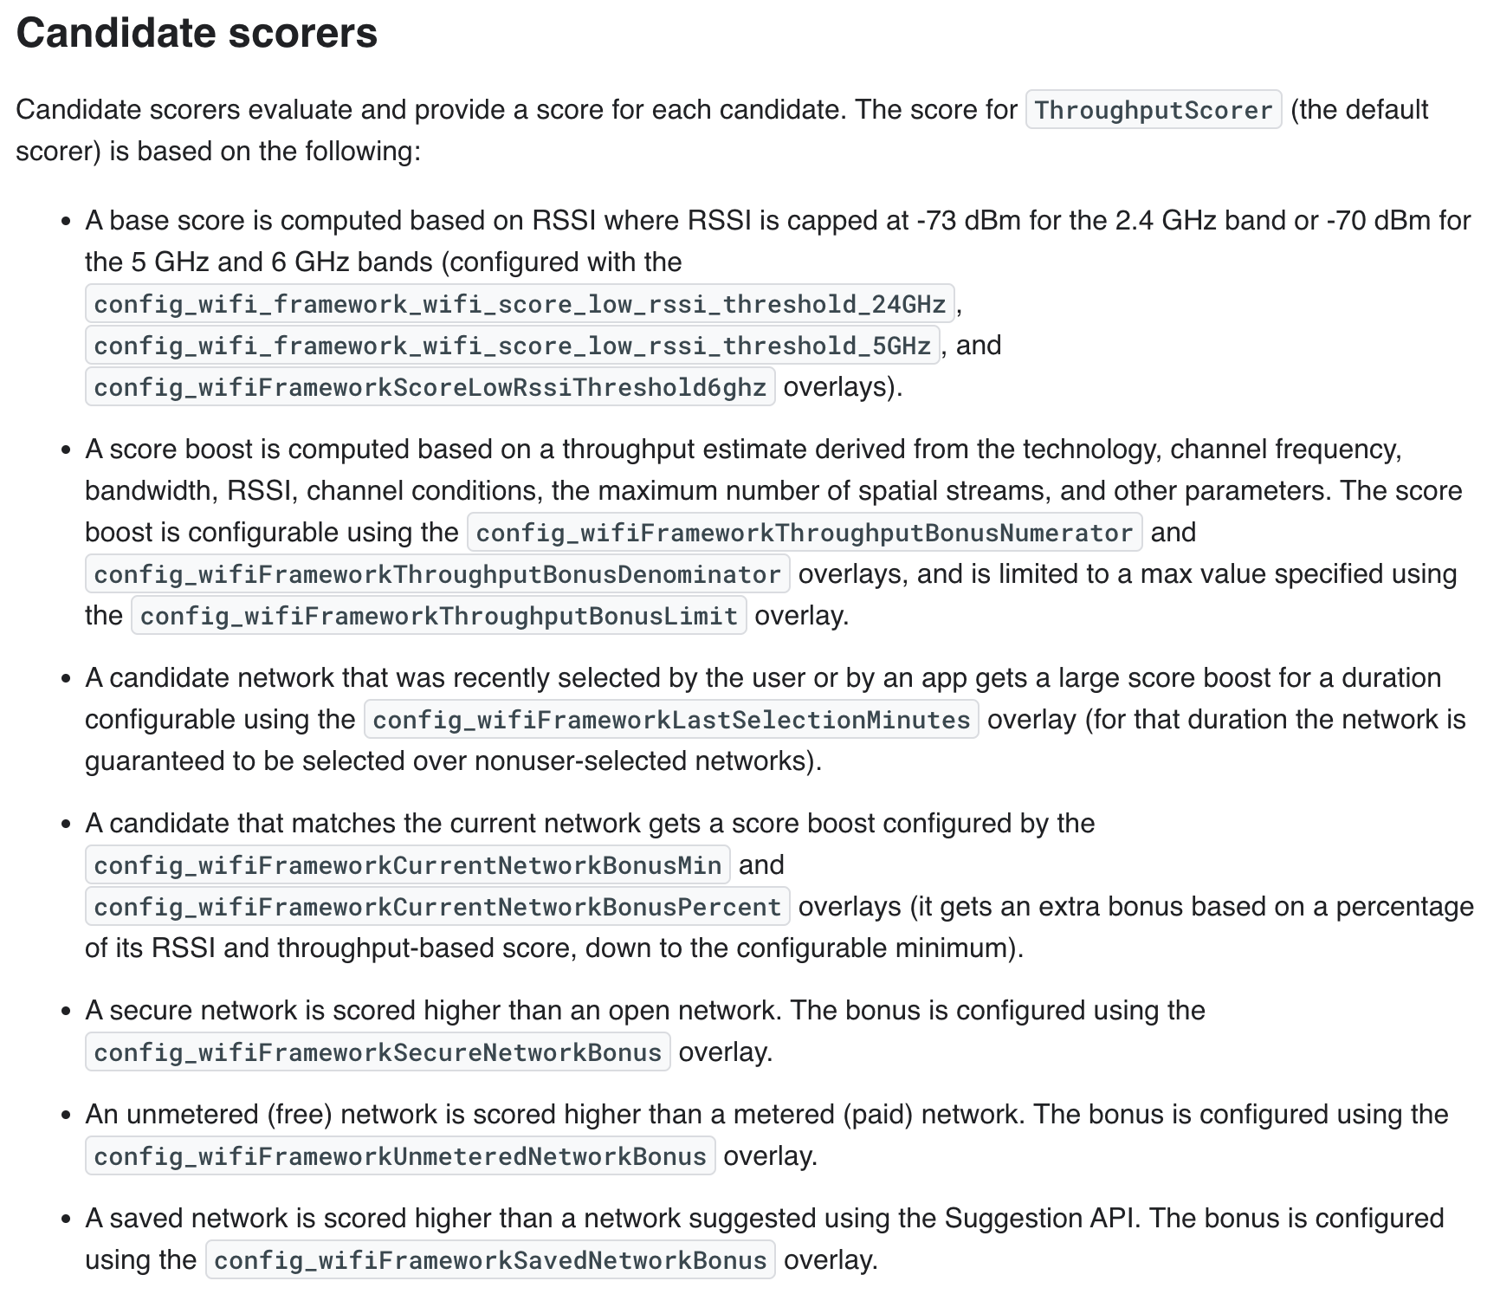
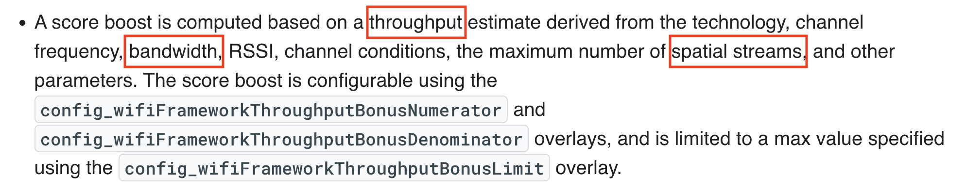
https://source.android.com/docs/core/connect/wifi-network-selection#candidate-scorers

Slide 12

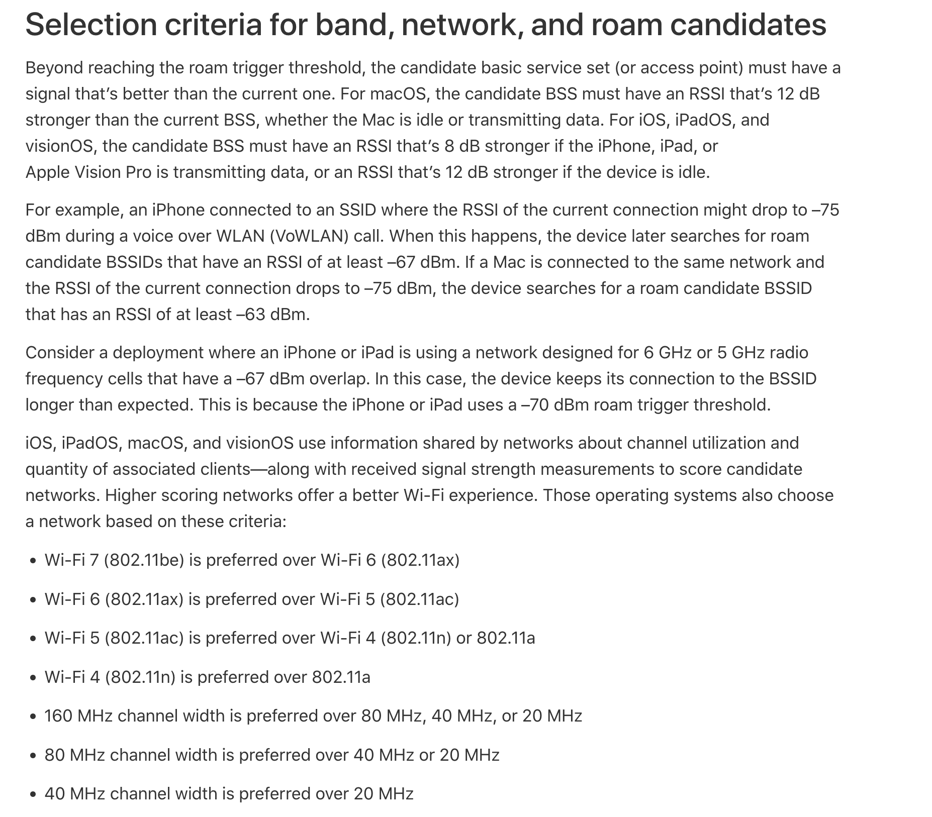
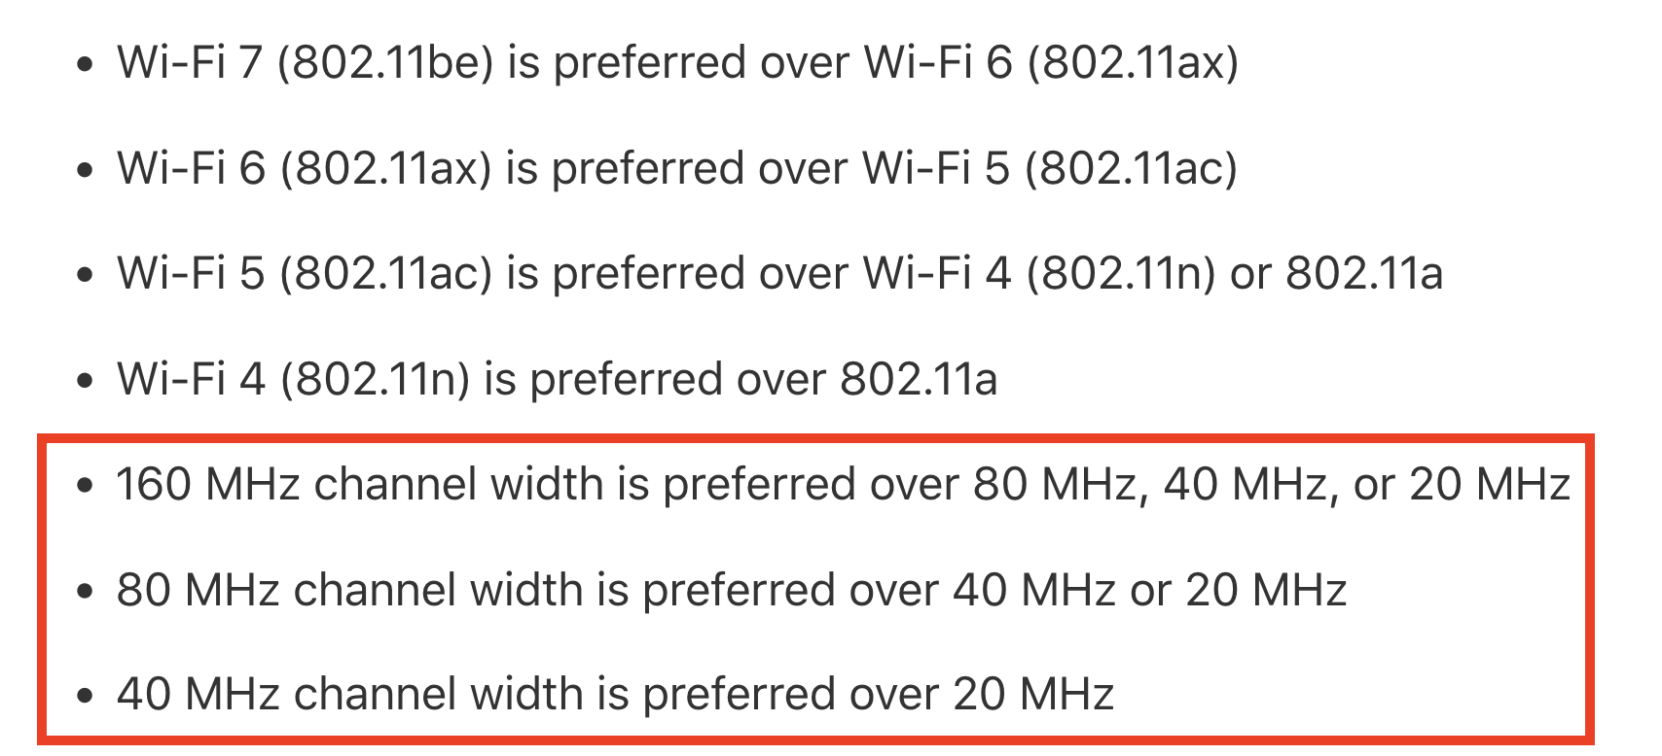
https://support.apple.com/guide/deployment/wi-fi-roaming-support-dep98f116c0f

Slide 13
Tri-band 2.4/5/6 – 20/20/80 MHz Increase Ch. Width on 6 GHz to 80 MHz
Device | 2.4GHz | 5GHz | 6GHz | Roams
Google Pixel 8 (Wi-Fi 7) | 10% | 5% | 85% | 20
Intel BE200 (Wi-Fi 7) | 0% | 0% | 100% | 20
iPhone 15 Pro (Wi-Fi 6E) | 12% | 0% | 88% | 16
M2 MacBook Pro (Wi-Fi 6E) | 6% | 0% | 94% | 18
MediaTek MT7902 (Wi-Fi 6E) | 0% | 0% | 100% | 7
MediaTek MT7922 (Wi-Fi 6E) | 0% | 5% | 95% | 20
Qualcomm WCN7851 (Wi-Fi 7) | 5% | 30% | 65% | 20
Notes:
All device love wider channels!

Slide 14
Tri-Band 2.4/5/6 – 20/40/80 MHz Mixed Channel Widths
Device | 2.4GHz | 5GHz | 6GHz | Roams
Google Pixel 8 (Wi-Fi 7) | 0% | 0% | 100% | 24
Intel BE200 (Wi-Fi 7) | 0% | 0% | 100% | 19
iPhone 15 Pro (Wi-Fi 6E) | 46% | 15% | 38% | 13
M2 MacBook Pro (Wi-Fi 6E) | 0% | 0% | 100% | 19
MediaTek MT7902 (Wi-Fi 6E) | 29% | 0% | 71% | 7
MediaTek MT7922 (Wi-Fi 6E) | 0% | 0% | 100% | 20
Qualcomm WCN7851 (Wi-Fi 7) | 14% | 5% | 81% | 21

Slide 15
Dual-band (5 & 6 GHz Only)
Notes:
No 2.4 GHz

Slide 16
Dual-Band 5/6 GHz - 40/80 MHz 5 + 6 GHz Only Test
Device | 2.4GHz | 5GHz | 6GHz | Roams
Google Pixel 8 (Wi-Fi 7) | 0% | 3% | 97% | 31
Intel BE200 (Wi-Fi 7) | 0% | 0% | 100% | 13
iPhone 15 Pro (Wi-Fi 6E) | 0% | 50% | 50% | 18
M2 MacBook Pro (Wi-Fi 6E) | 0% | 0% | 100% | 20
MediaTek MT7902 (Wi-Fi 6E) | 0% | 20% | 80% | 10
MediaTek MT7922 (Wi-Fi 6E) | 0% | 8% | 92% | 13
Qualcomm WCN7851 (Wi-Fi 7) | 0% | 61% | 39% | 18
Notes:
Pretty much all clients prefer

Slide 17
Does USING non-PSC Impact Roaming?

Slide 18
Tri-band 2.4/5/6 – 20/40/40 MHz Non-PSC Test
Device | 2.4GHz | 5GHz | 6GHz | Roams
Google Pixel 8 (Wi-Fi 7) | 21% | 4% | 75% | 24
Intel BE200 (Wi-Fi 7) | 0% | 0% | 100% | 12
iPhone 15 Pro (Wi-Fi 6E) | 50% | 9% | 41% | 22
M2 MacBook Pro (Wi-Fi 6E) | 0% | 0% | 100% | 19
MediaTek MT7902 (Wi-Fi 6E) | 0% | 90% | 10% | 10
MediaTek MT7922 (Wi-Fi 6E) | 0% | 62% | 38% | 21
Qualcomm WCN7851 (Wi-Fi 7) | 0% | 36% | 64% | 22
Notes:
Mediatek adapters struggle with Non-PSC channels

Slide 19
Does 802.11k impact roaming?

Slide 20
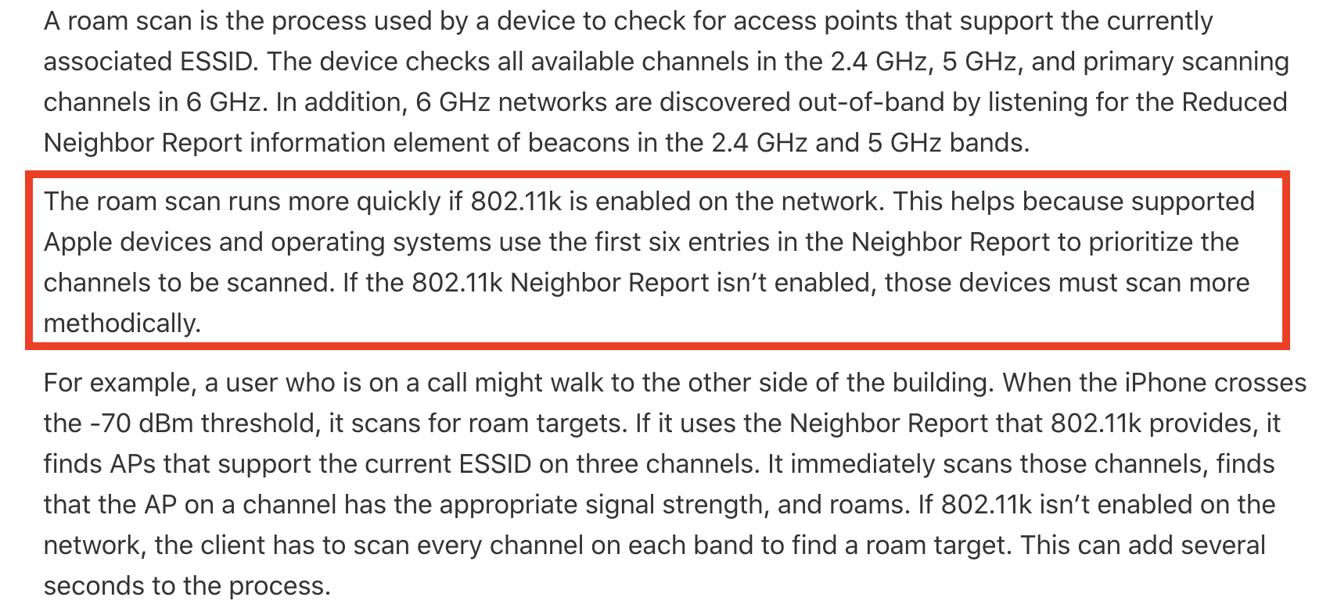
iOS & 802.11k
https://support.apple.com/guide/deployment/wi-fi-roaming-support-dep98f116c0f/web

Slide 21
Tri-Band 2.4/5/6 – 20/40/80 MHz 802.11k enabled
Device | 2.4GHz | 5GHz | 6GHz | Roams
Google Pixel 8 (Wi-Fi 7) | 4% | 0% | 96% | 27
Intel BE200 (Wi-Fi 7) | 0% | 0% | 100% | 20
iPhone 15 Pro (Wi-Fi 6E) | 31% | 3% | 66% | 29
M2 MacBook Pro (Wi-Fi 6E) | 0% | 0% | 100% | 19
Mediatek MT7902 (Wi-Fi 6E) | 0% | 14% | 86% | 7
Mediatek MT7922 (Wi-Fi 6E) | 0% | 10% | 90% | 20
Qualcomm WCN7851 (Wi-Fi 7) | 10% | 25% | 65% | 20

Slide 22
No 11k vs 11k enabled
Device | 2.4GHz | 5GHz | 6GHz | Roams | Test
Google Pixel 8 (Wi-Fi 7) | 0% | 0% | 100% | 24 | Tri-Band 20-40-80 MHz
Google Pixel 8 (Wi-Fi 7) | 4% | 0% | 96% | 27 | Tri-Band 20-40-80 MHz + 11k
Intel BE200 (Wi-Fi 7) | 0% | 0% | 100% | 19 | Tri-Band 20-40-80 MHz
Intel BE200 (Wi-Fi 7) | 0% | 0% | 100% | 20 | Tri-Band 20-40-80 MHz + 11k
iPhone 15 Pro (Wi-Fi 6E) | 46% | 15% | 38% | 13 | Tri-Band 20-40-80 MHz
iPhone 15 Pro (Wi-Fi 6E) | 31% | 3% | 66% | 29 | Tri-Band 20-40-80 MHz + 11k
M2 MacBook Pro (Wi-Fi 6E) | 0% | 0% | 100% | 19 | Tri-Band 20-40-80 MHz
M2 MacBook Pro (Wi-Fi 6E) | 0% | 0% | 100% | 19 | Tri-Band 20-40-80 MHz + 11k
MediaTek MT7902 (Wi-Fi 6E) | 29% | 0% | 71% | 7 | Tri-Band 20-40-80 MHz
MediaTek MT7902 (Wi-Fi 6E) | 0% | 14% | 86% | 7 | Tri-Band 20-40-80 MHz + 11k
MediaTek MT7922 (Wi-Fi 6E) | 0% | 0% | 100% | 20 | Tri-Band 20-40-80 MHz
MediaTek MT7922 (Wi-Fi 6E) | 0% | 10% | 90% | 20 | Tri-Band 20-40-80 MHz + 11k
Qualcomm WCN7851 (Wi-Fi 7) | 14% | 5% | 81% | 21 | Tri-Band 20-40-80 MHz
Qualcomm WCN7851 (Wi-Fi 7) | 10% | 25% | 65% | 20 | Tri-Band 20-40-80 MHz + 11k

Slide 23
MLO and Roaming

Slide 24
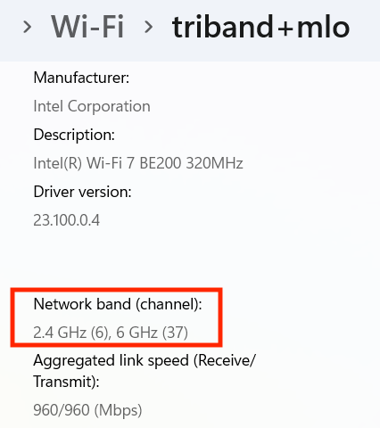
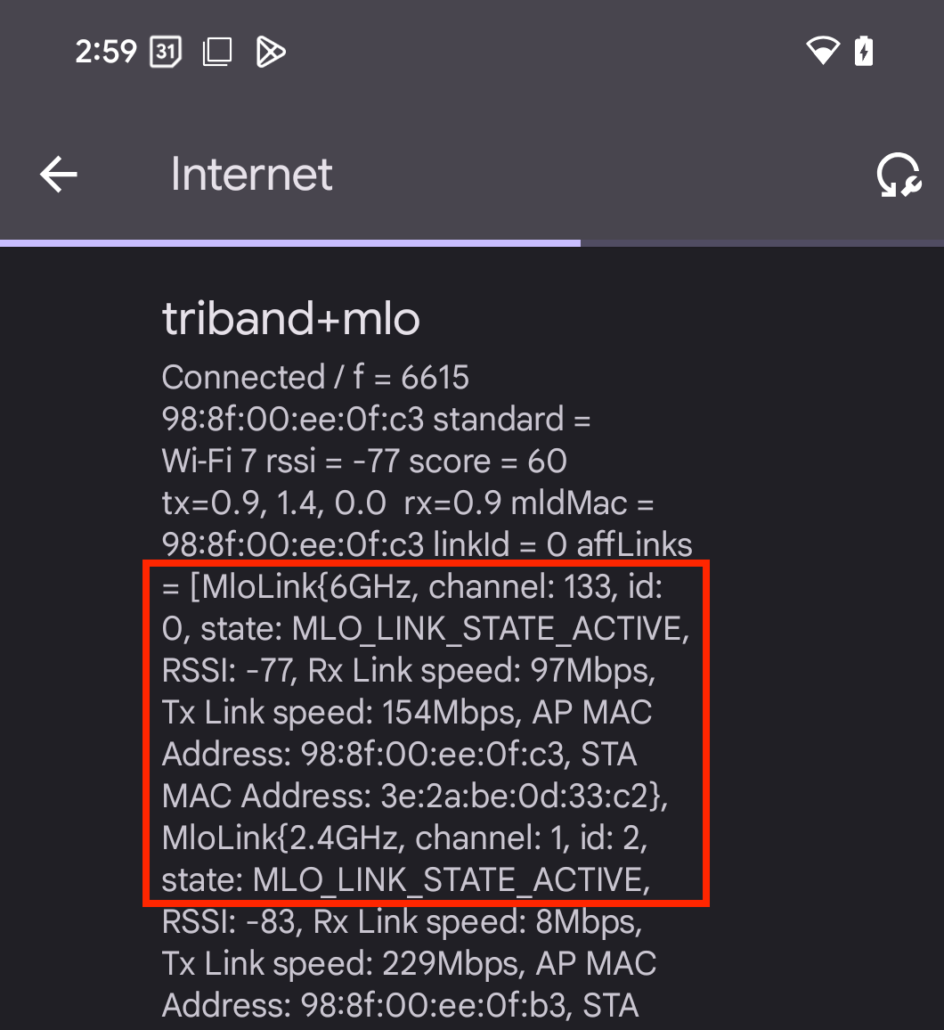
MLO Compatibility
Windows
Android

Slide 25
Compare: No MLO vs MLO Enabled
Device | 2.4GHz | 5GHz | 6GHz | Roams
Google Pixel 8 (Wi-Fi 7) | 0% | 0% | 100% | 24
Google Pixel 8 (Wi-Fi 7) | 19% | 38% | 44% | 16 | w/ MLO
Intel BE200 (Wi-Fi 7) | 0% | 0% | 100% | 19
Intel BE200 (Wi-Fi 7) | 0% | 0% | 100% | 14 | w/ MLO
Qualcomm WCN7851 (Wi-Fi 7) | 14% | 5% | 81% | 21
Qualcomm WCN7851 (Wi-Fi 7) | 14% | 14% | 71% | 14 | w/ MLO

Slide 26
FILS Discovery (6 GHz Only)

Slide 27
6 GHz Only FILS Discovery Method
Device | 2.4GHz | 5GHz | 6GHz | Roams
Google Pixel 8 (Wi-Fi 7) | 0% | 0% | 100% | 2
Intel BE200 (Wi-Fi 7) | 0% | 0% | 100% | 8
iPhone 15 Pro (Wi-Fi 6E) | 0% | 0% | 100% | 7
M2 MacBook Pro (Wi-Fi 6E) | 0% | 0% | 100% | 18
Mediatek MT7902 (Wi-Fi 6E) | 0% | 0% | 100% | 4
Mediatek MT7922 (Wi-Fi 6E) | 0% | 0% | 100% | 19
Qualcomm WCN7851 (Wi-Fi 7) | 0% | 0% | 100% | 20

Slide 28
6 GHz Design Considerations
Optimize Tx power for 6 GHz
Design for secondary coverage
Use a wider channel on 6 GHz – Typically 80 MHz, if channel reuse allows
Use PSC channels when possible
Some AP vendors may not support using 40 MHz channels on PSC’s

Slide 29
6 GHz Design Considerations (Cont.)
Avoid mixing channel widths within the same band
Consider disabling some or all 2.4 GHz radios
Enable 802.11k, especially if supporting iOS devices
Some devices prefer 6 GHz more than others (Ex. MacBook & Intel BE200)
Avoid using 6 GHz only (FILS Discovery), use RNR by also enabling 5 GHz (or 2.4 GHz)

Slide 30
Tools Used To Capture Roaming DATA

Slide 31

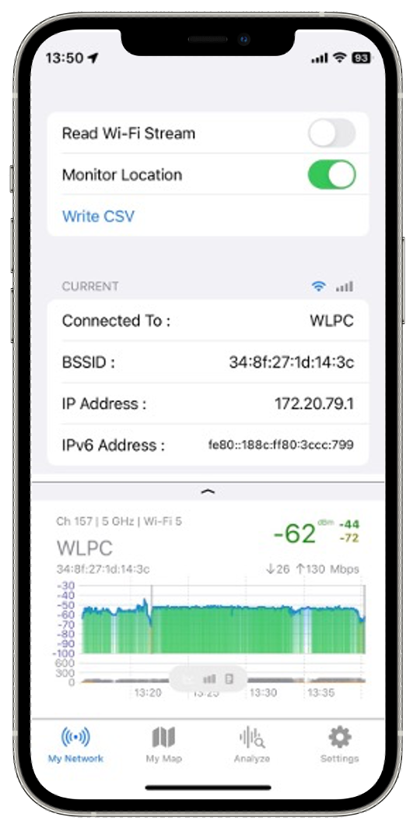
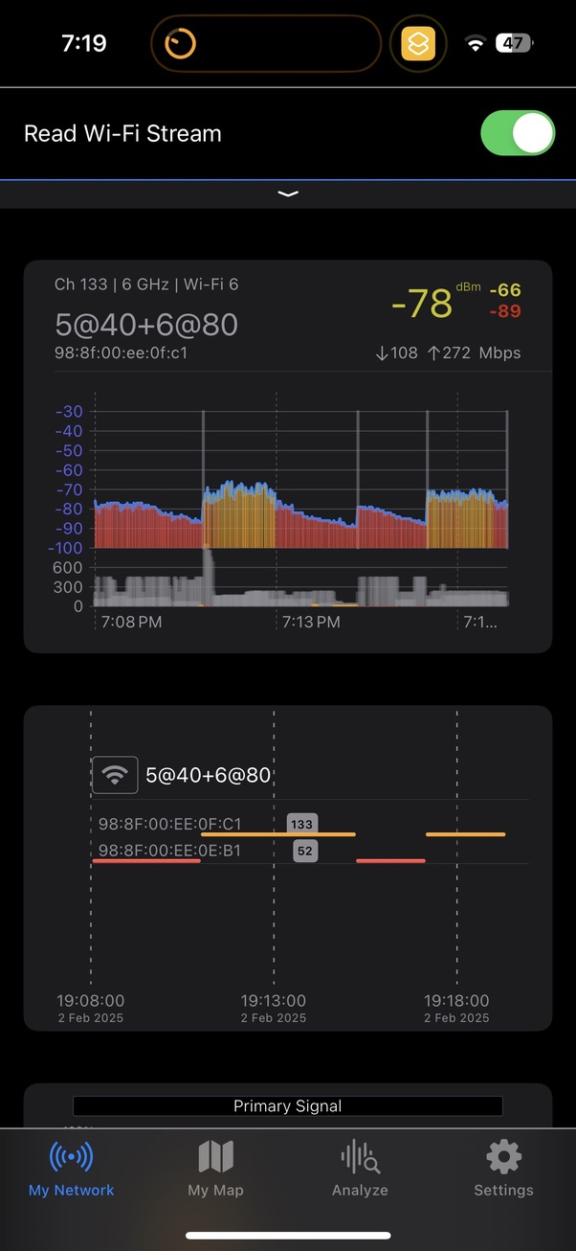
iPhone/iPad
nOversight WiFi Analyzer
iOS app, available in app store
Live Wi-Fi analysis
Export roaming events to CSV file
https://www.numerousnetworks.co.uk

Slide 32
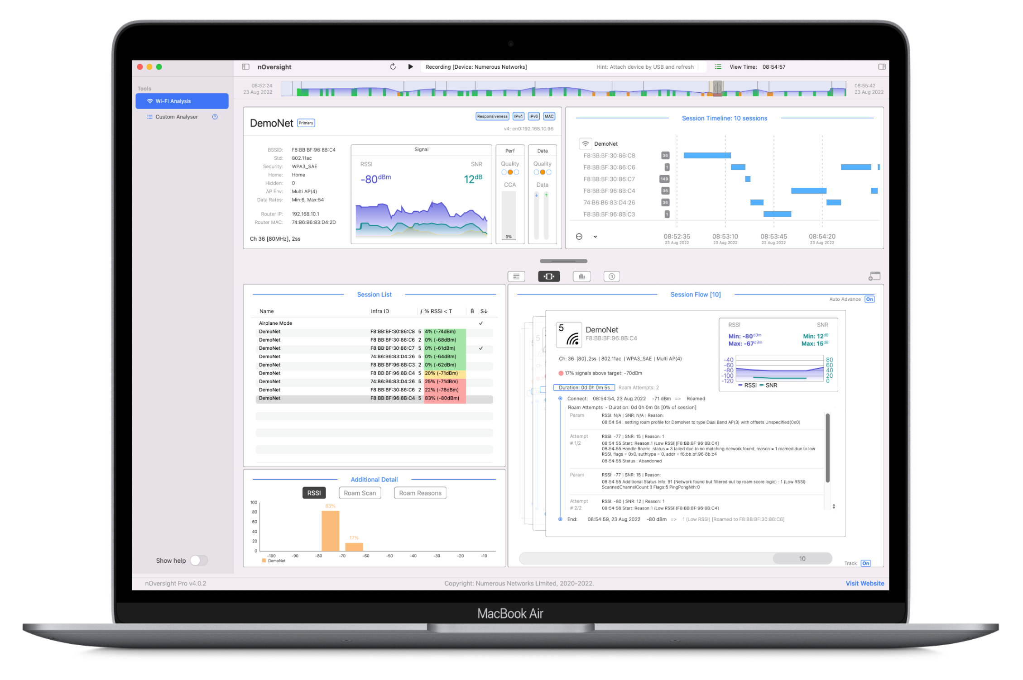
macOS
nOversight Pro
Analyze Mac Roaming Behavior in detail
Record, Save, and Playback sessions
Analyze logs from iPhone/iPad
https://www.numerousnetworks.co.uk

Slide 33

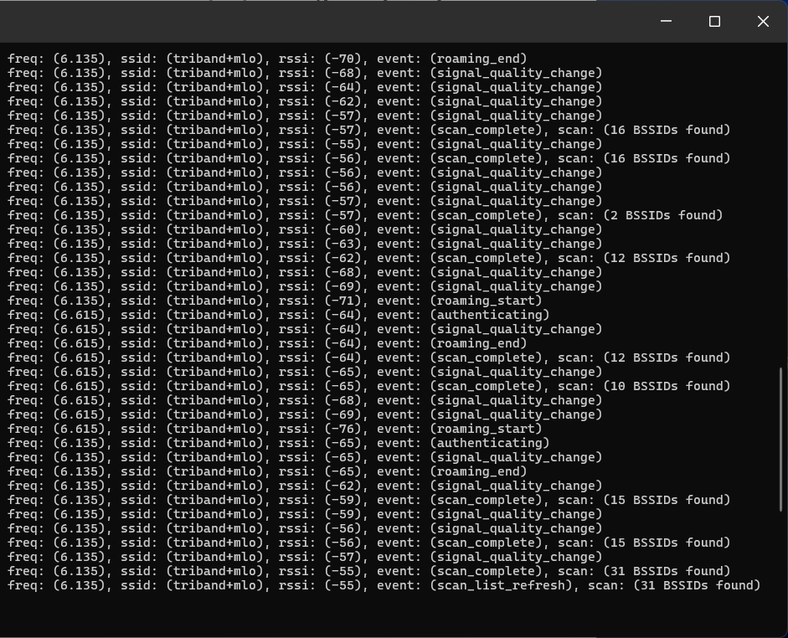
Windows
LSWIFI
CLI-centric Wi-Fi scanning tool for Windows
Live Wi-Fi connection analysis
Captures Wi-Fi roaming events
Log events to Remote Syslog Server
https://github.com/joshschmelzle/lswifi

Slide 34
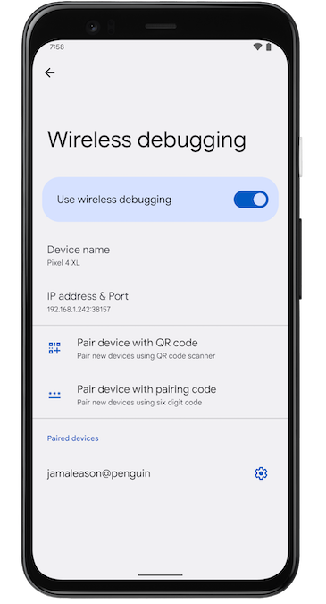
Android
Enable Developer Options and USB Debugging
Use adb (Android Debug Bridge)
Real-time Logging with adb logcat
adb logcat -b all | grep -i wifi
Record Wi-Fi Roaming Events
adb logcat -b all | grep -i "roam\|BSSID\|RSSI\|handover" > wifi_roaming_log.txt

Slide 35


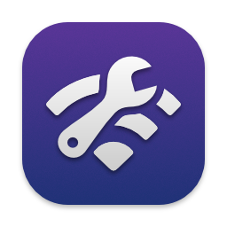
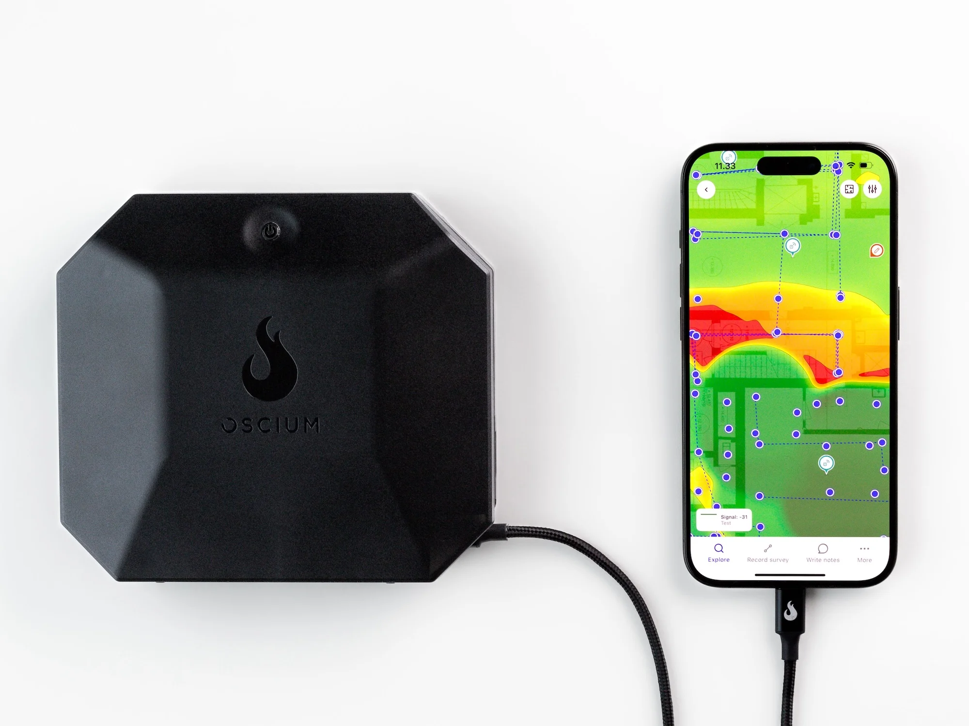
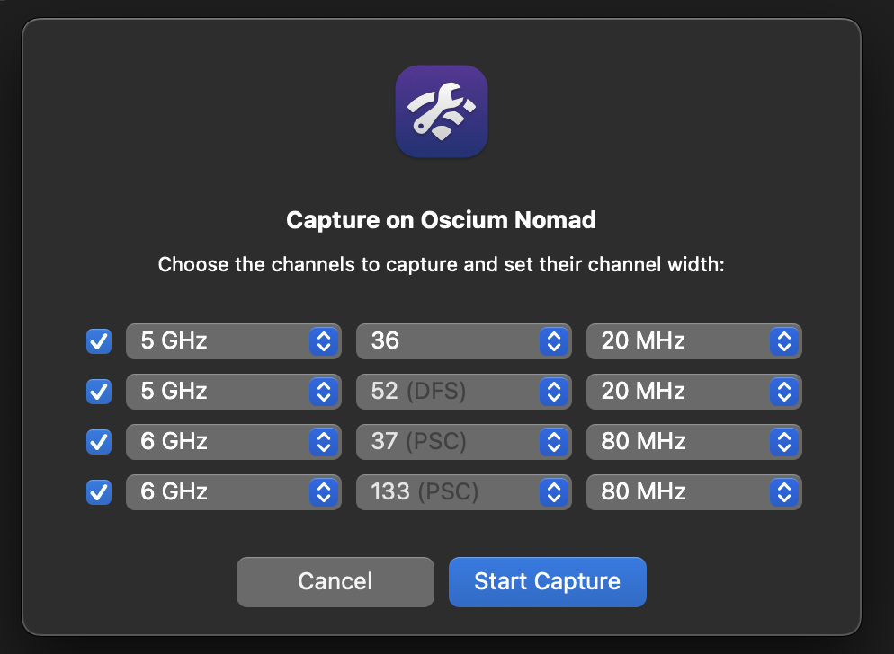
Wi-Fi 7 Capture Solution
+
+
Oscium Nomad – Wi-Fi Measurement Device
4 Tri-band radios
Wi-Fi 7 capable
Intuitibits Airtool 2 – macOS app for capturing Wi-Fi traffic using your Mac’s adapter
Capture Wi-Fi packets on up to 4 channels simultaneously
Save to PCAP or stream directly into Wireshark
https://oscium.com/
https://www.intuitibits.com
+

Slide 36
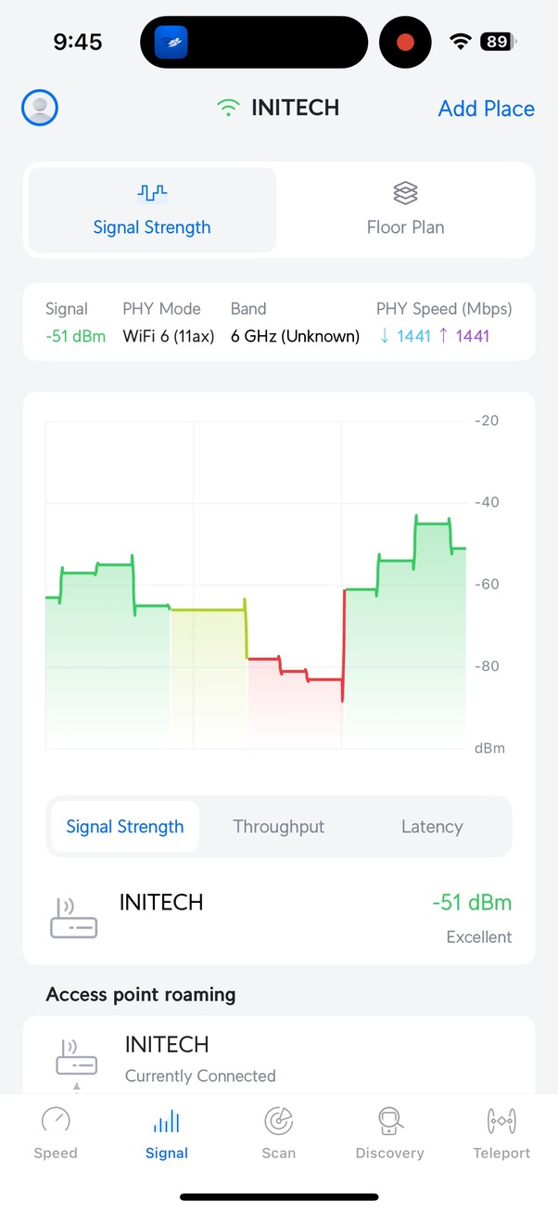
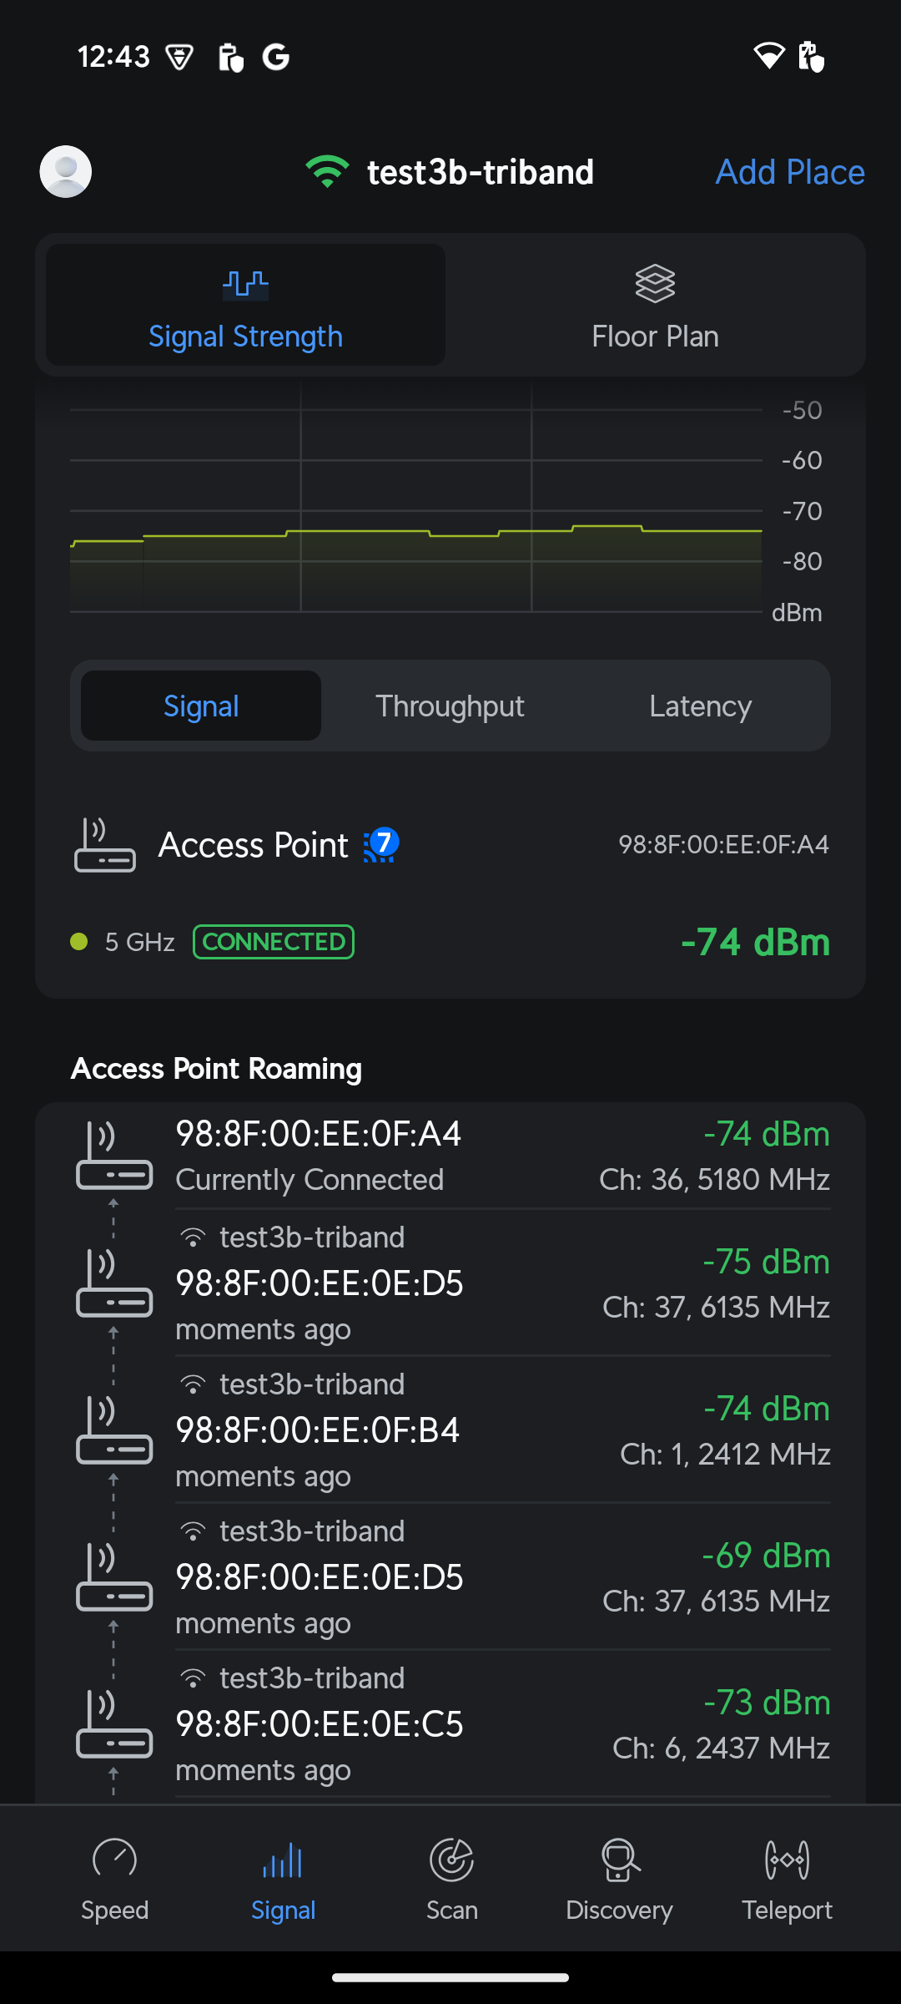

Real-time Roaming Analysis
Ubiquiti WiFiman
Android & iOS
Live Roaming Analysis

Slide 37
Demo

Slide 38

Testing Results & slides
https://github.com/jolla/roaming-wars

